Slide 1
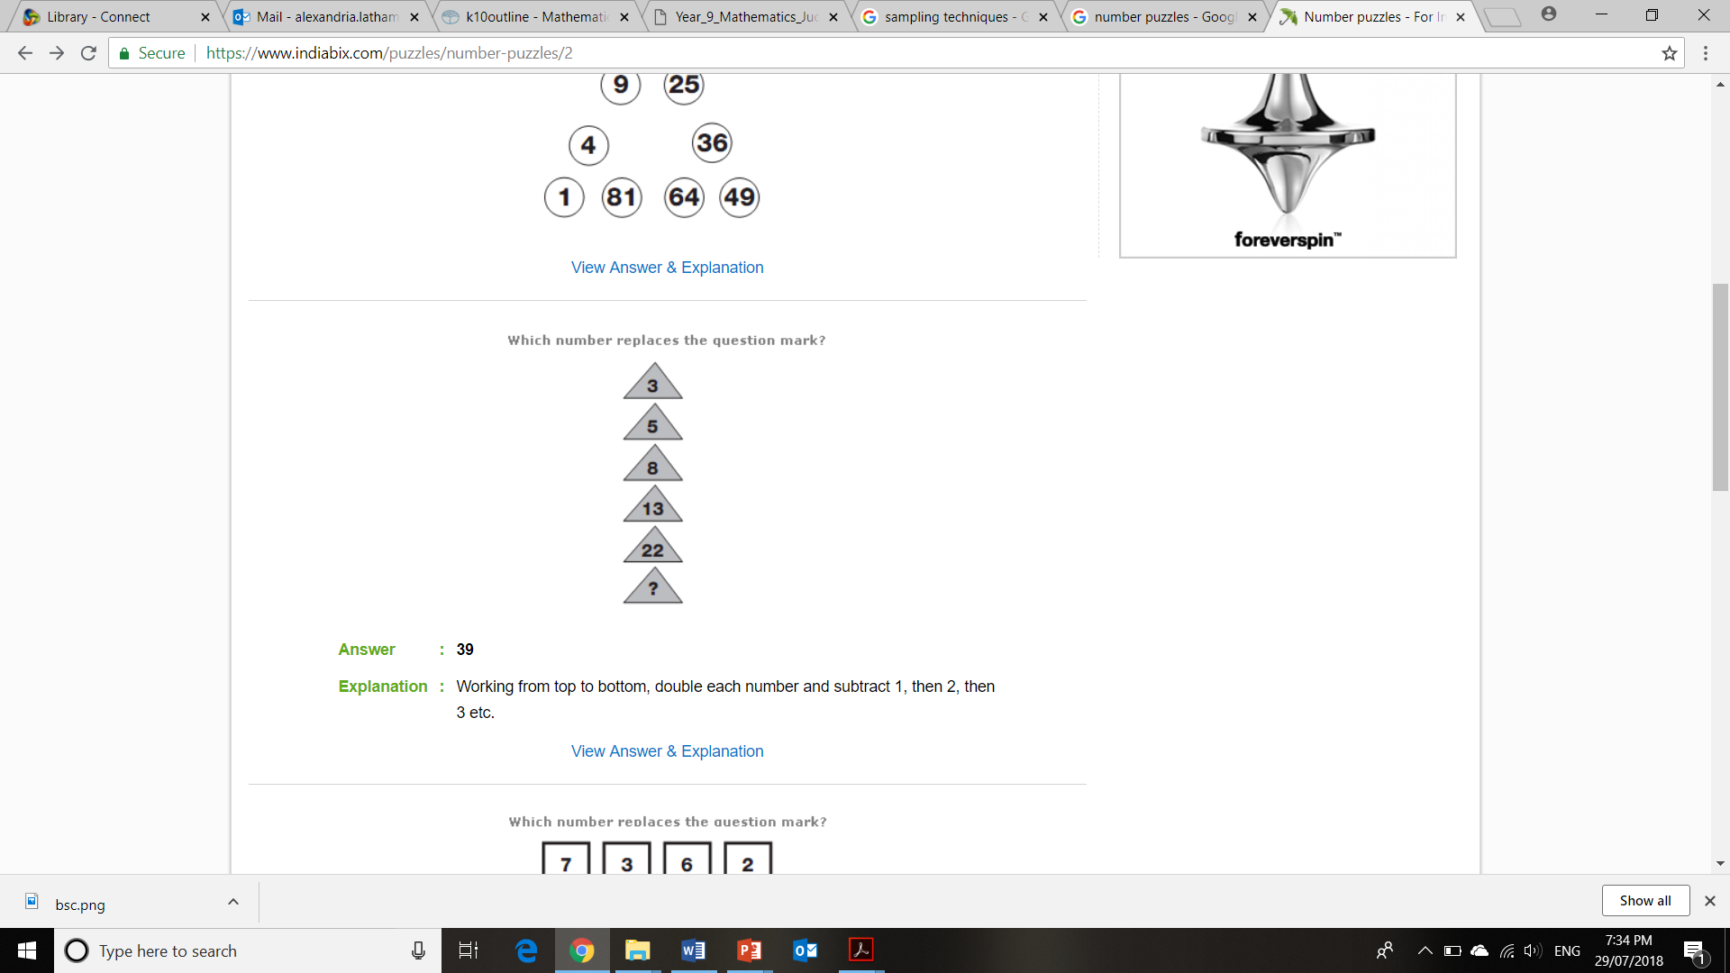
Topic: Adding and Subtracting Fractions
Topic
EQ
Rule up your page like this!
Summary
EQ:
Ms. Latham

Slide 2
Add a Slide Title - 1

Slide 3
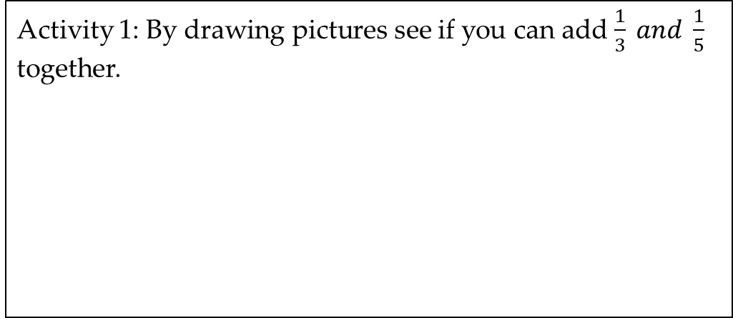
Topic: Adding and Subtracting Fractions
EQ: How can we develop a visual model for adding and subtracting fractions?
Activity 1: By drawing pictures see if you can add $\frac{1}{3} and \frac{1}{5}$ together.

Slide 4
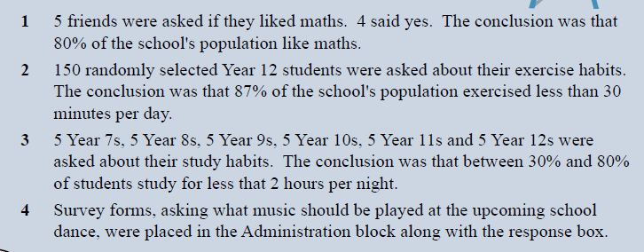
What is wrong with each of the following questions? How could you improve these??

